Slide 1
IE 440
PROCESS IMPROVEMENT
THROUGH PLANNED EXPERIMENTATION
Some Important Discrete Probability Distributions
Dr. Xueping Li
University of Tennessee

Slide 2
Chapter Topics
The Probability of a Discrete Random Variable
Covariance and Its Applications in Finance
Binomial Distribution
Poisson Distribution
Hypergeometric Distribution

Slide 3

Random Variable
Random Variable
  Outcomes of an experiment expressed numerically
  E.g., Toss a die twice; count the number of times the number 4 appears (0, 1 or 2 times)
  E.g., Toss a coin; assign $10 to head and -$30 to a tail
= $10
T
= -$30

Slide 4
Discrete Random Variable
Discrete Random Variable
  Obtained by counting (0, 1, 2, 3, etc.)
  Usually a finite number of different values
  E.g., Toss a coin 5 times; count the number of tails (0, 1, 2, 3, 4, or 5 times)

Slide 5


Discrete Probability Distribution Example
Event: Toss 2 Coins Count # Tails
Probability Distribution
Values Probability
0 1/4 = .25
1 2/4 = .50
2 1/4 = .25
T
T
T
T
This is using the A Priori Classical Probability approach.

Slide 6
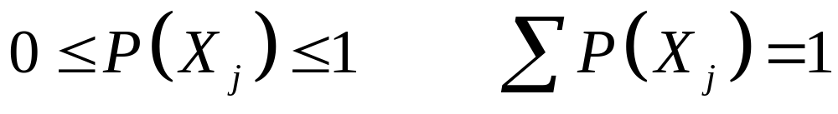
Discrete Probability Distribution
List of All Possible [X_{j} , P(X_{j}) ] Pairs
  X_{j} = Value of random variable
  P(X_{j}) = Probability associated with value
Mutually Exclusive (Nothing in Common)
Collective Exhaustive (Nothing Left Out)

Slide 7
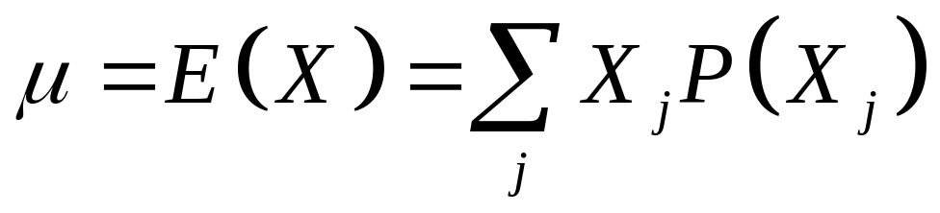
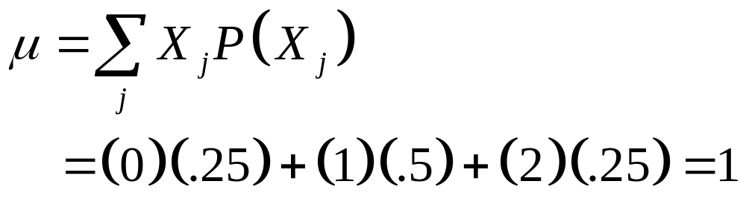
Summary Measures
Expected Value (The Mean)
  Weighted average of the probability distribution
  E.g., Toss 2 coins, count the number of tails, compute expected value:

Slide 8
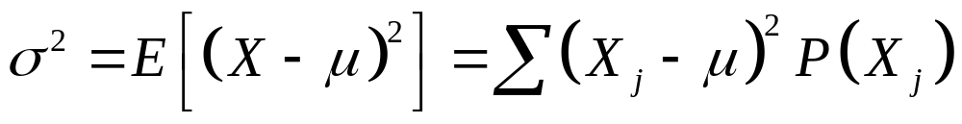
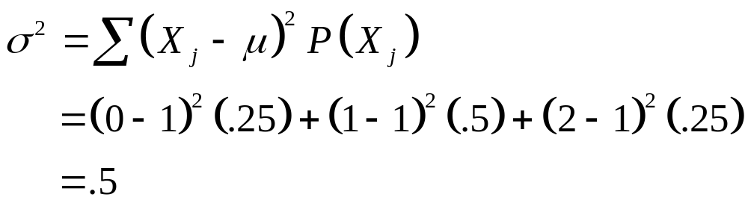
Summary Measures
(continued)
Variance
  Weighted average squared deviation about the mean
  E.g., Toss 2 coins, count number of tails, compute variance:

Slide 9
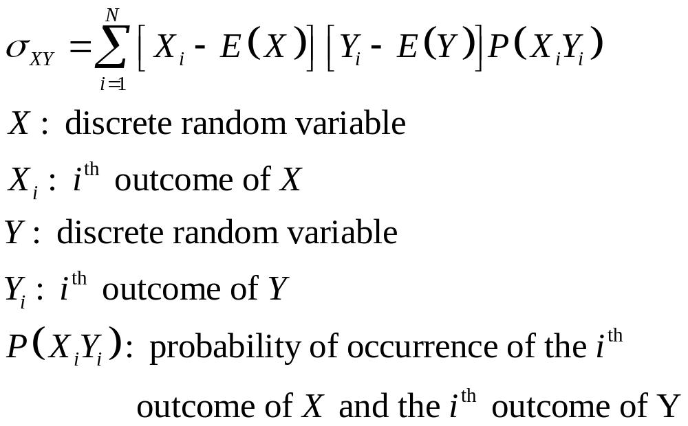
Covariance and Its Application

Slide 10
Computing the Mean for Investment Returns
Return per $1,000 for two types of investments
Investment
P(X_{i}) P(Y_{i}) Economic Condition Dow Jones Fund X Growth Stock Y
.2 .2 Recession -$100 -$200
.5 .5 Stable Economy + 100 + 50
.3 .3 Expanding Economy + 250 + 350

Slide 11
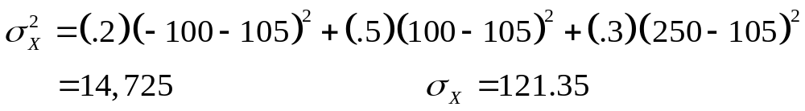
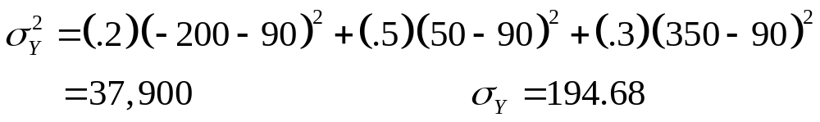
Computing the Variance for Investment Returns
Investment
P(X_{i}) P(Y_{i}) Economic Condition Dow Jones Fund X Growth Stock Y
.2 .2 Recession -$100 -$200
.5 .5 Stable Economy + 100 + 50
.3 .3 Expanding Economy + 250 + 350

Slide 12
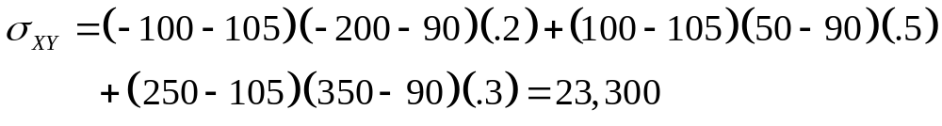
Computing the Covariance for Investment Returns
Investment
P(X_{i}Y_{i}) Economic Condition Dow Jones Fund X Growth Stock Y
.2 Recession -$100 -$200
.5 Stable Economy + 100 + 50
.3 Expanding Economy + 250 + 350
The covariance of 23,000 indicates that the two investments are positively related and will vary together in the same direction.

Slide 13
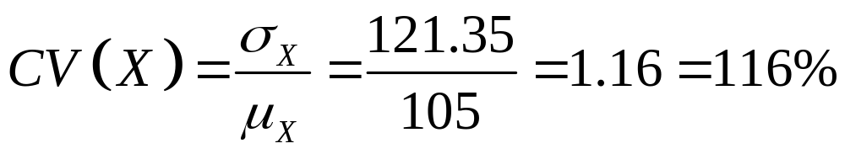
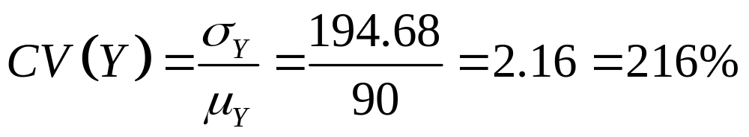
Computing the Coefficient of Variation for Investment Returns
Investment X appears to have a lower risk (variation) per unit of average payoff (return) than investment Y
Investment X appears to have a higher average payoff (return) per unit of variation (risk) than investment Y

Slide 14
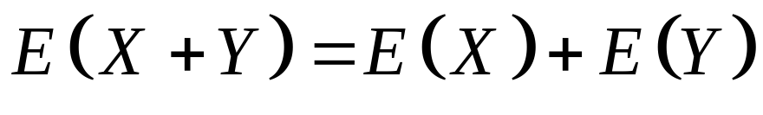
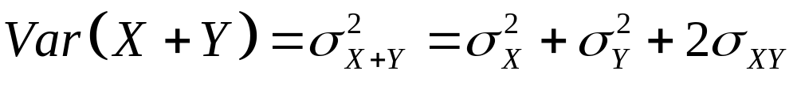
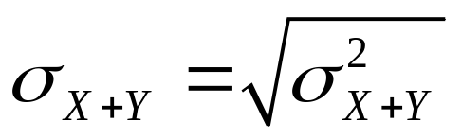
Sum of Two Random Variables
The expected value of the sum is equal to the sum of the expected values
The variance of the sum is equal to the sum of the variances plus twice the covariance
The standard deviation is the square root of the variance

Slide 15
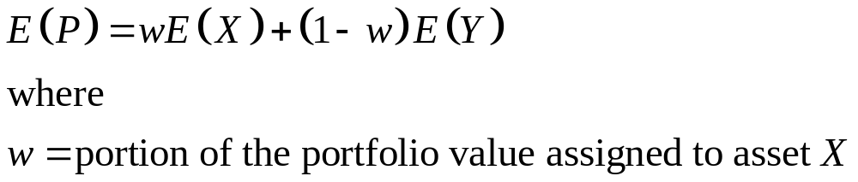
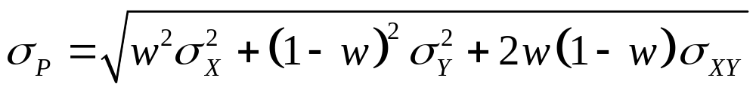
Portfolio Expected Return and Risk
The portfolio expected return for a two-asset investment is equal to the weighted average of the two assets
Portfolio risk

Slide 16
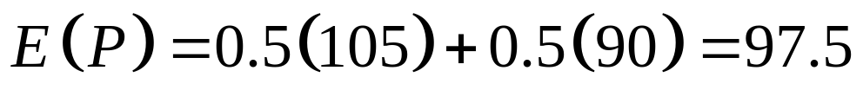
Computing the Expected Return and Risk of the Portfolio Investment
Investment
P(X_{i}Y_{i}) Economic Condition Dow Jones Fund X Growth Stock Y
.2 Recession -$100 -$200
.5 Stable Economy + 100 + 50
.3 Expanding Economy + 250 + 350
Suppose a portfolio consists of an equal investment in each of X and Y:

Slide 17

Doing It in PHStat
PHStat | Decision Making | Covariance and Portfolio Analysis
  Fill in the “Number of Outcomes:”
  Check the “Portfolio Management Analysis” box
  Fill in the probabilities and outcomes for investment X and Y
  Manually compute the CV using the formula in the previous slide
Here is the Excel spreadsheet that contains the results of the previous investment example:

Slide 18
Important Discrete Probability Distributions
Discrete Probability Distributions
Binomial
Hypergeometric
Poisson

Slide 19
Binomial Probability Distribution
‘n’ Identical Trials
  E.g., 15 tosses of a coin; 10 light bulbs taken from a warehouse
2 Mutually Exclusive Outcomes on Each Trial
  E.g., Heads or tails in each toss of a coin; defective or not defective light bulb
Trials are Independent
  The outcome of one trial does not affect the outcome of the other

Slide 20
Binomial Probability Distribution
(continued)
Constant Probability for Each Trial
  E.g., Probability of getting a tail is the same each time we toss the coin
2 Sampling Methods
  Infinite population without replacement
  Finite population with replacement

Slide 21
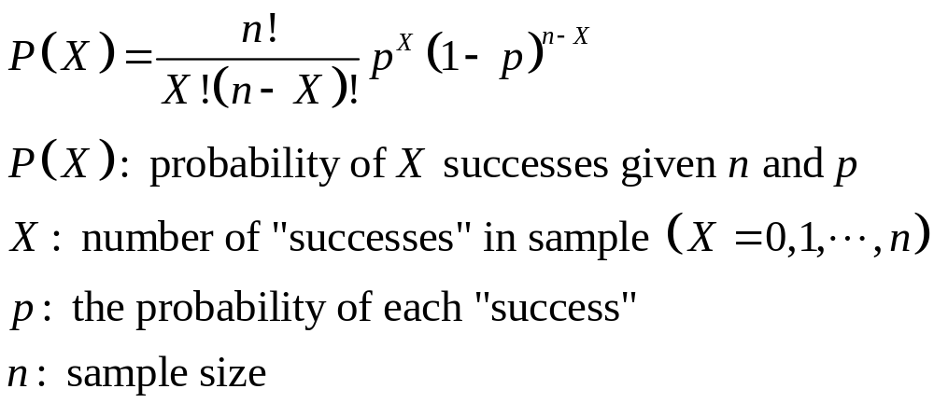
Binomial Probability Distribution Function
Tails in 2 Tosses of Coin
X P(X)
0 1/4 = .25
1 2/4 = .50
2 1/4 = .25

Slide 22
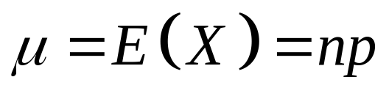
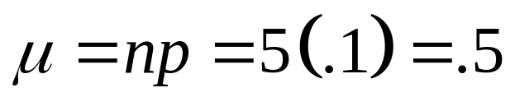
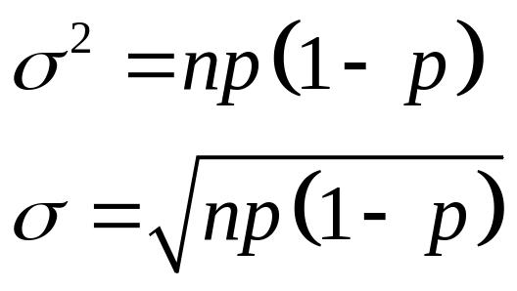
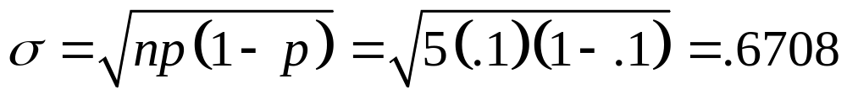
Binomial Distribution Characteristics
Mean
  E.g.,
Variance and
Standard Deviation
  E.g.,
P(X)
n = 5 p = 0.1
.6
.4
.2
0
X
0
1
2
3
4
5

Slide 23

Binomial Distribution in PHStat
PHStat | Probability & Prob. Distributions | Binomial
Example in Excel Spreadsheet

Slide 24

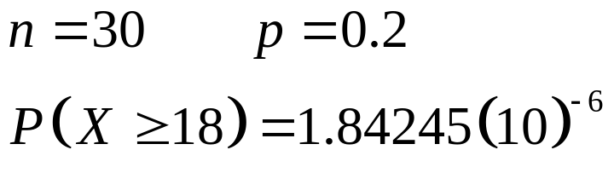
Example: Binomial Distribution
A mid-term exam has 30 multiple choice questions, each with 5 possible answers. What is the probability of randomly guessing the answer for each question and passing the exam (i.e., having guessed at least 18 questions correctly)?
Are the assumptions for the binomial distribution met?
Yes, the assumptions are met.
Using results from PHStat:

Slide 25
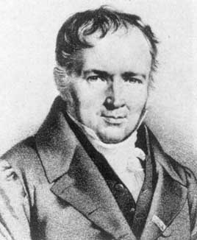
Poisson Distribution
Siméon Poisson

Slide 26
Poisson Distribution
Discrete events (“successes”) occurring in a given area of opportunity (“interval”)
  “Interval” can be time, length, surface area, etc.
The probability of a “success” in a given “interval” is the same for all the “intervals”
The number of “successes” in one “interval” is independent of the number of “successes” in other “intervals”
The probability of two or more “successes” occurring in an “interval” approaches zero as the “interval” becomes smaller
  E.g., # customers arriving in 15 minutes
  E.g., # defects per case of light bulbs

Slide 27
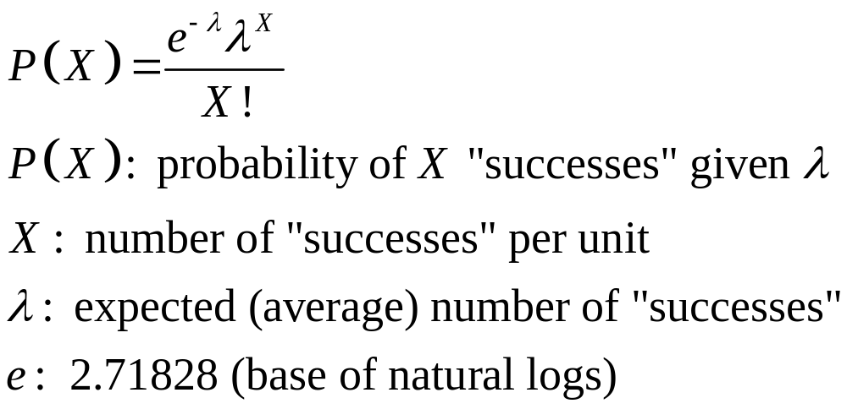
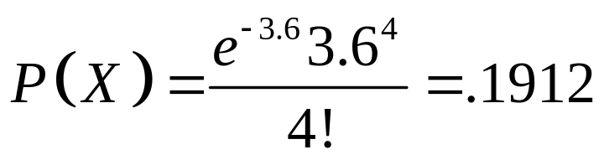
Poisson Probability Distribution Function
E.g., Find the probability of 4 customers arriving in 3 minutes when the mean is 3.6.

Slide 28

Poisson Distribution in PHStat
PHStat | Probability & Prob. Distributions | Poisson
Example in Excel Spreadsheet
P
(
X
=
x
|
λ
-
e
λ
x
λ
x
!
Notes:
9999999999999999

Slide 29
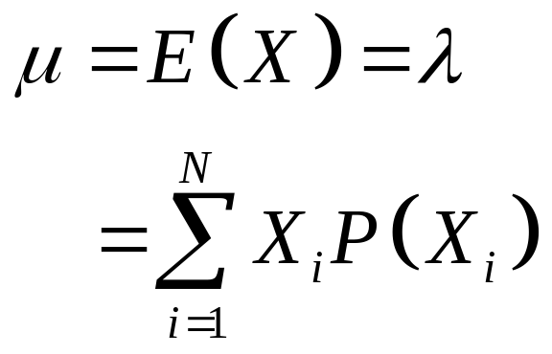
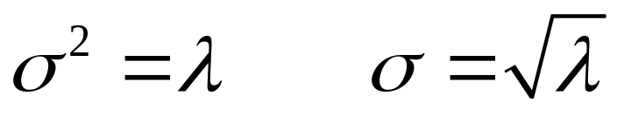
Poisson Distribution Characteristics
P(X)
λ = 0.5
Mean
Standard Deviation
and Variance
.6
.4
.2
0
X
0
1
2
3
4
5
P(X)
λ = 6
.6
.4
.2
0
X
0
2
4
6
8
10

Slide 30
Hypergeometric Distribution
“n” Trials in a Sample Taken from a Finite Population of Size N
Sample Taken Without Replacement
Trials are Dependent
Concerned with Finding the Probability of “X” Successes in the Sample Where There are “A” Successes in the Population

Slide 31
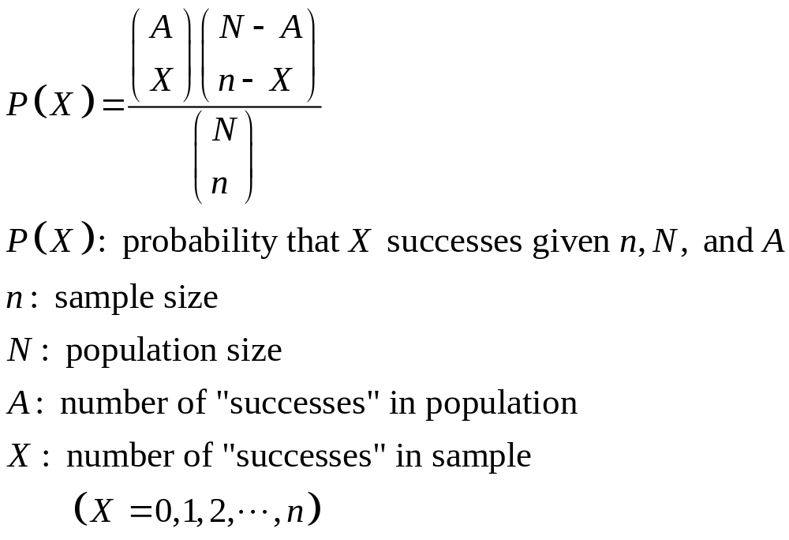
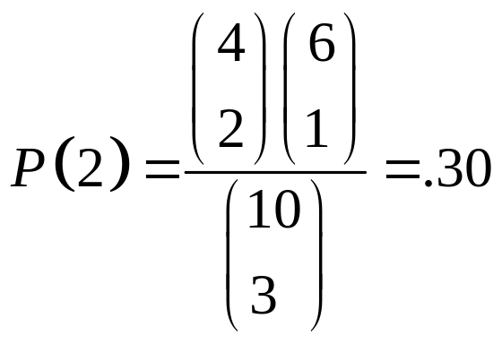
Hypergeometric Distribution Function
E.g., 3 Light bulbs were selected from 10. Of the 10, there were 4 defective. What is the probability that 2 of the 3 selected are defective?

Slide 32
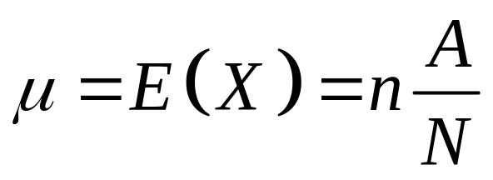
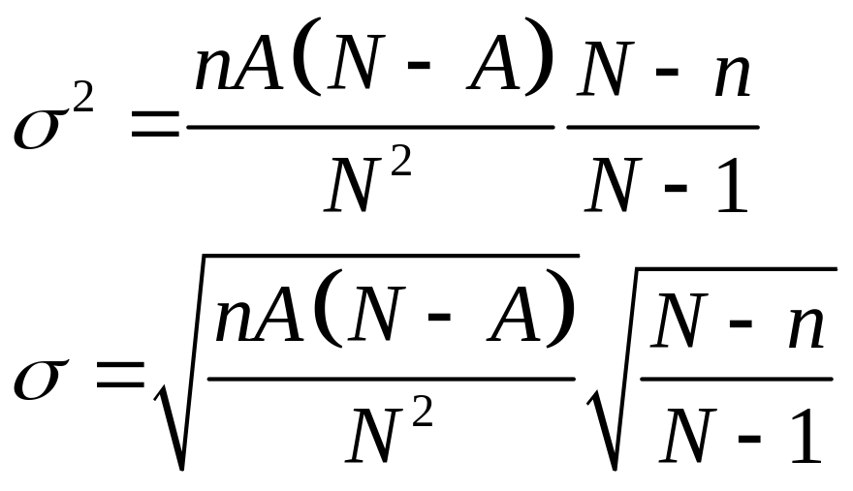
Hypergeometric Distribution Characteristics
Mean
Variance and Standard Deviation
Finite
Population
Correction
Factor

Slide 33
Hypergeometric Distribution in PHStat
PHStat | Probability & Prob. Distributions | Hypergeometric …
Example in Excel Spreadsheet

Slide 34
Chapter Summary
Addressed the Probability of a Discrete Random Variable
Defined Covariance and Discussed Its Application in Finance
Discussed Binomial Distribution
Addressed Poisson Distribution
Discussed Hypergeometric Distribution

